Slide 1
Introduction to machine learning
Methods, applications, etc.

Slide 2
Overview
What is machine learning?
Applications of machine learning
Types of algorithms
Basics of statistical pattern recognition
Preprocessing
Feature Extraction/Selection
Learning
Final remarks

Slide 3
Overview
What is machine learning?
Applications of machine learning
Types of algorithms
Basics of statistical pattern recognition
Preprocessing
Feature Extraction/Selection
Learning
Final remarks

Slide 4
What is Machine Learning?
“Field of study that gives computers the ability to learn without being explicitly programmed”
Arthur Samuel (1959)
“A computer program is said to learn from experience E with respect to some class of tasks T and performance measure P, if its performance at tasks in T, as measured by P, improves with experience E”
Tom M. Mitchell (1998)

Slide 5
Example: Spam Email Detection
“A computer program is said to learn from experience E with respect to some class of tasks T and performance measure P, if its performance at tasks in T, as measured by P, improves with experience E”
In our project,
T: classify emails as spam or not spam
E: watch the user label emails as spam or not spam
P: percentage of correctly-identified emails

Slide 6
Overview
What is machine learning?
Applications of machine learning
Types of algorithms
Basics of statistical pattern recognition
Preprocessing
Feature Extraction/Selection
Learning
Final remarks

Slide 7
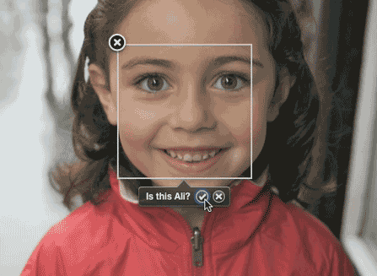
Applications of Machine Learning
Facial recognition
Notes:
Training examples: tagged photos of person of interest
Output: prediction if picture is of person of interest

Slide 8
Applications of Machine Learning
Self-customizing programs (Netflix, Amazon, etc.)
Notes:
Input: movies watched and movies rated positively
Output: prediction of movies that watcher will enjoy

Slide 9
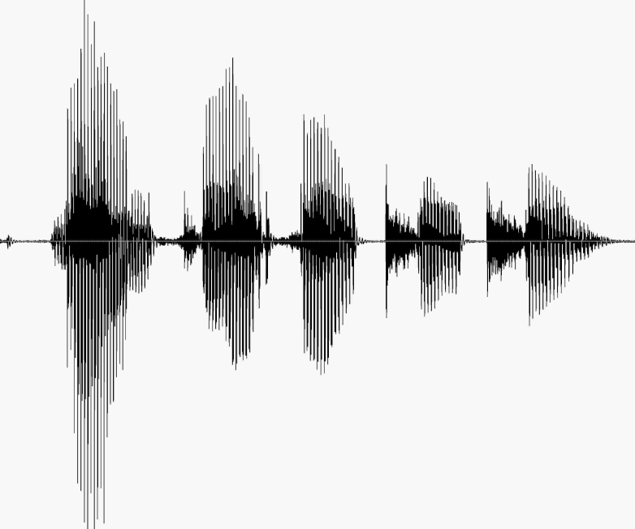
Applications of Machine Learning
Speech recognition
Notes:
Input: speech waveform
Output: actual words spoken

Slide 10
Applications of Machine Learning
Other applications:
Spam detection
Internet search
Data mining medical records
Many more!
Notes:
Spam detection – classify emails into spam vs ham
Internet search – select most relevent web pages
Medical records – predict disease or risks from patterns in medical data

Slide 11
Overview
What is machine learning?
Applications of machine learning
Types of algorithms
Basics of statistical pattern recognition
Preprocessing
Feature Extraction/Selection
Learning
Final remarks

Slide 12
Supervised Learning
Given labeled training examples
Find correct prediction for an unlabeled example
E.g. Handwriting recognition
Notes:
Supervised Learning –
We know the correct answer

Slide 13
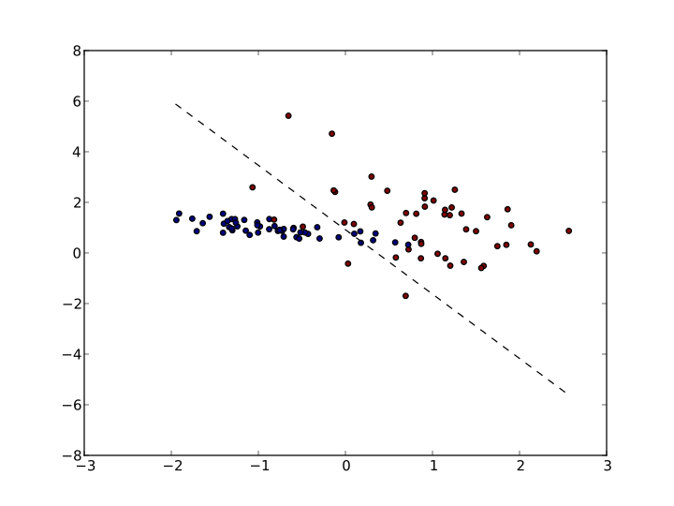
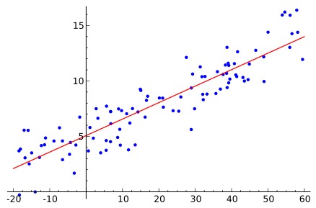
Types of Supervised Learning Problems
Classification
Regression
Predict whether a given input belongs to one of multiple classes
Output is discrete
Given the input, predict a continuous output
Output is continuous
Notes:
Two main types of supervised learning problems

Slide 14
Unsupervised Learning
Given unlabeled training samples
Discover low dimensional patterns, structure
E.g. Cluster news articles by topic
Notes:
Need to seek out patterns in the data

Slide 15
Reinforcement Learning
Learn from delayed feedback
E.g. Machine learns how to play chess
Notes:
Example – learn from past experience
In chess, the computer will learn which positions lead to winning games

Slide 16
Overview
What is machine learning?
Applications of machine learning
Types of algorithms
Basics of statistical pattern recognition
Preprocessing
Feature Extraction/Selection
Learning
Final remarks

Slide 17
Model of Statistical Pattern Recognition
Training (learning): classifier is trained to partition the feature space
Classification (testing): classifier assigns input pattern to one of pattern classes based on measured features
Figure: Model for statistical pattern recognition

Slide 18
Model of Statistical Pattern Recognition
Preprocessing: clean up the data
Separate data from background
Remove noise
Figure: Model for statistical pattern recognition

Slide 19
Model of Statistical Pattern Recognition
Feature Extraction/ Selection
Find the appropriate features for representing the training examples
Translate data into a vector space
Vector has d feature values
Figure: Model for statistical pattern recognition

Slide 20
Feature Extraction/ Selection
Feature vector: representation of real world objects
Choice of representation strongly influences results
Curse of Dimensionality
The number of examples needed to train increases rapidly with the number of features used
Feature Selection: select a subset of features that leads to smallest classification errors
Feature Extraction: create new features based on transformations or combinations of original features
Notes:
Want to reduce the number of features needed

Slide 21
Model of Statistical Pattern Recognition
Learning
The classifier is trained to identify the correct classes
Can use various methods to train the classifier
Figure: Model for statistical pattern recognition

Slide 22
Learning
Class-conditional densities: probability of feature vector belonging to class defined as
Known: optimal Bayes decision rule can be used
Unknown: must be learned
Figure: Model for statistical pattern recognition

Slide 23
Learning
Form of class-conditional densities
Parametric: form is known, some parameters unknown
E.g. we know the data is Gaussian
Nonparametric: form is unknown
Either estimate density function or construct decision boundary rules
Figure: Model for statistical pattern recognition

Slide 24
Learning
Figure: various approaches in statistical pattern recognition

Slide 25
Overview
What is machine learning?
Applications of machine learning
Types of algorithms
Basics of statistical pattern recognition
Preprocessing
Feature Extraction/Selection
Learning
Final remarks

Slide 26
Summary
Machine learning: computers learn from experience to improve performance of certain tasks
Many useful applications that we use today
Different steps to machine learning process
Preprocessing
Feature Extraction/Selection
Learning
Type of problem will affect which approach you decide to use

Slide 27
Sources
“Statistical Pattern Recognition: A Review”
Jain, Anil. K; Duin, Robert. P.W.; Mao, Jianchang (2000). “Statistical pattern recognition: a review”. IEEE Transtactions on Pattern Analysis and Machine Intelligence 22 (1): 4-37
“Machine Learning” Online Course
Andrew Ng
http://openclassroom.stanford.edu/MainFolder/CoursePage.php?course=MachineLearning
“Machine Learning” Course
Kilian Weinberger
http://www.cse.wustl.edu/~kilian/cse517a2010/

Slide 28
Image Sources
http://googlenewsblog.blogspot.com/2009_05_01_archive.html
https://www.coursera.org/course/ml
http://visionwang.com/2009/01/11/apples-iphoto-vs-googles-picasa-technology-and-strategy/
http://www.techhive.com/article/2024221/
http://forums.macrumors.com/showthread.php?t=480428
http://www.stanford.edu/class/cs224s/
http://en.wikipedia.org/wiki/Machine_learning

Slide 29
Thank you
Any questions?

