Slide 1
Dimensionality reduction: feature extraction & feature selection
Principle Component Analysis

Slide 2
Why Dimensionality Reduction?
It becomes more difficult to extract meaningful conclusions from a data set as data dimensionality increases--------D. L. Donoho
Curse of dimensionality
The number of training needed grow exponentially with the number of features
Peaking phenomena
Performance of a classifier degraded if sample size/# of feature is small
error cannot be reliably estimated when sample size/# of features is small

Slide 3
High dimensionality breakdown k-Nearest Neighbors Algorithm
Assume 5000 points uniformly distributed in the unit sphere and we will select 5 nearest neighbors.
1-Dimension
5/5000=0.001 distance
2-Dimension
Must √0.001=0.03 circle area to get 5 neighbors
100-dimension
(0.001)^{(1/100)}=0.94≈1
All points spread to the surface of the high-dimensional structure so that nearest neighbor does not exits

Slide 4
Advantages vs. Disadvantages
Advantages
Disadvantages
Simplify the pattern representation and the classifiers
Faster classifier with less memory consumption
Alleviate curse of dimensionality with limited data sample
Loss information
Increased error in the resulting recognition system

Slide 5
Feature Selection & Extraction
Transform the data in high-dimensional to fewer dimensional space
Dataset {x⁽¹⁾, x⁽²⁾,…, x^{(m)}} where x^{(i)} C R^{n} to {z⁽¹⁾, z⁽²⁾,…, z^{(m)}} where z^{(i)} C R^{k} , with k<=n

Slide 6
Solution: Dimensionality Reduction
Feature Extraction
Feature Selection
Determine the appropriate subspace of dimensionality k from the original d-dimensional space, where k≤d
Given a set of d features, select a subset of size k that minimized the classification error.

Slide 7
Feature Extraction Methods
Picture by Anil K. Jain etc.

Slide 8
Feature Selection Method
Picture by Anil K. Jain etc.

Slide 9
Principal Components Analysis(PCA)
What is PCA?
A statistical method to find patterns in data
What are the advantages?
Highlight similarities and differences in data
Reduce dimensions without much information loss
How does it work?
Reduce from n-dimension to k-dimension with k<n
Example in R²
Example in R³

Slide 10
Data Redundancy Example
Original Picture by Andrew Ng
Correlation between x1 and x2=1.
For any highly correlatedx1, x2, information is redundant
Vector z1
Vector z1

Slide 11
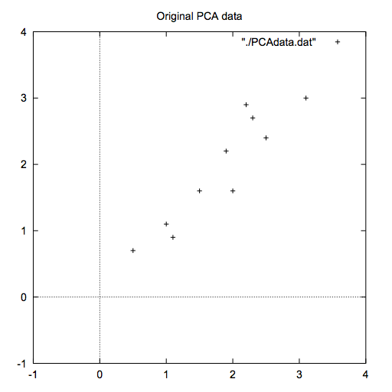
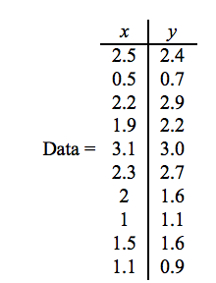
Method for PCA using 2-D example
Step 1. Data Set (mxn)
Lindsay I Smith
Lindsay I Smith

Slide 12
Find the vector that best fits the data
y
Data was represented in x-y frame
Can be
Transformed to frame of eigenvectors
x
Lindsay I Smith

Slide 13
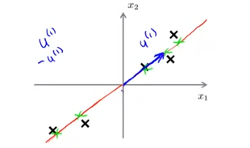
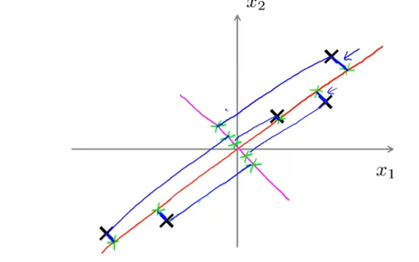
PCA 2-dimension example
Goal: find a direction vector u in R² onto which to project all the data so as to minimize the error (distance from data points to the chosen line)
Andrew Ng’s machine learning course lecture

Slide 14
PCA vs Linear Regression
PCA
Linear Regression
By Andrew Ng

Slide 15
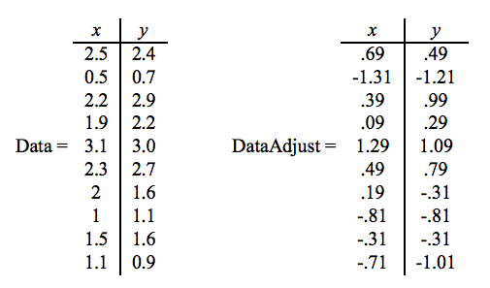
Method for PCA using 2-D example
Step 2. Subtract the mean
Lindsay I Smith

Slide 16
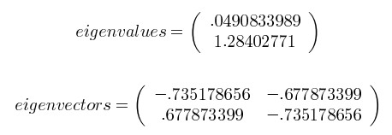
Method for PCA using 2-D example
Step 3. Calculate the covariance matrix
Step 4. Eigenvalues and unit eigenvectors of the covariance matrix
[U,S,V]=svd(sigma) or eig(sigma) in Matlab

Slide 17
Method for PCA using 2-D example
Step 5. Choosing and forming feature vector
Order the eigenvectors by eigenvalues from highest to lowest
Most Significant: highest eigenvalue
Choose k vectors from n vectors: reduced dimension
Lose some but not much information
Most Significant: highest eigenvalue
k
In Matlab: Ureduce=U(:,1:k) extract first k vectors

Slide 18
Step 6. Deriving new data set
(kxm)
RowFeatureVector
RowDataAdjust
Transposed feature vector (k by n)
Mean-adjusted vector (n by m)
eig1 eig2 eig3 … eig_{k}
Most significant vector
col1 col2 col3…colm

Slide 19
Transformed Data Visualization I
eigvector2
eigvector1
Lindsay I Smith

Slide 20
Transformed Data Visualization II
y
eigenvector1
x
Lindsay I Smith

Slide 21
3-D Example
By Andrew Ng

Slide 22
Sources
“Statistical Pattern Recognition: A Review”
Jain, Anil. K; Duin, Robert. P.W.; Mao, Jianchang (2000). “Statistical pattern recognition: a review”. IEEE Transtactions on Pattern Analysis and Machine Intelligence 22 (1): 4-37
“Machine Learning” Online Course
Andrew Ng
http://openclassroom.stanford.edu/MainFolder/CoursePage.php?course=MachineLearning
Smith, Lindsay I. "A tutorial on principal components analysis." Cornell University, USA 51 (2002): 52.

Slide 23
Thank you!
Lydia Song

