Slide 1
Logistic Regression
L1, L2 Norm
Summary and addition to Andrew Ng’s lectures on machine learning

Slide 2
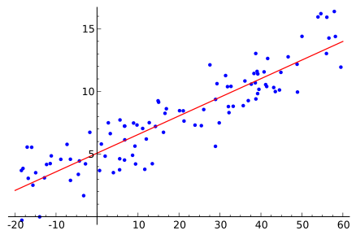
Linear Regression
Price($1000)
Predict continuous values as outcomes
Categorical outcome violates the linearity
y=x+5
http://en.wikipedia.org/wiki/File:Linear_regression.svg
Area(m^2)

Slide 3
What is Logistic Regression
A “classification algorithm”. In nature, it is a transformed linear regression
Transform the output to the range of 0~1 and then project the continuous results to discrete category
predict class label base on features
i.e. Predict whether a patient has a given disease based on their age, gender, body mass index, blood test, etc.

Slide 4
Two types of Logistic Regression
Binomial
Multinomial
two possible outcomes
i.e. spam or nor spam
3 or more types of outcomes
i.e. Disease A, B,C..

Slide 5
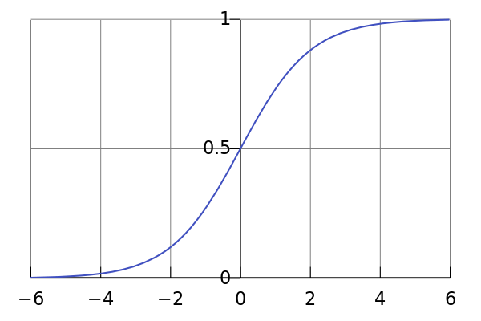
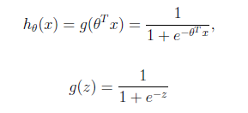
Logistic Function
http://en.wikipedia.org/wiki/File:Logistic-curve.svg

Slide 6
Logistic Function Summary
F(t): Probability of dependent variable belongs to the certain category
Link between linear regression and probability
-infinity<Input<infinity
Logistic function
0<=Output<=1

Slide 7
Decision Boundary
Continuous→Discrete
Y=1 if h_{θ}(x) ≥ 0.5
θ^{T}x ≥ 0
Y=0 if h_{θ}(x) < 0.5
θ^{T}x < 0

Slide 8
Linear Boundary Example
θ^{T}x =
θ^{T}x ≥ 0, fall on the
Upper side of the line,
Predicting y=1
θ^{T}x < 0, fall on the lower
side of the Line, predicting
Y=0
θ^{T}x

Slide 9
Nonlinear Boundary Example
θ^{T}x =
θ^{T}x ≥ 0, fall outside circle,
Predict y=1
θ^{T}x < 0, fall inside circle,
Predict y=0

Slide 10
Cost Function for Linear Regression
Cost function of linear regression
Can not be applied to logistic regression, because the function is non-convex and thus hard to be minimized

Slide 11
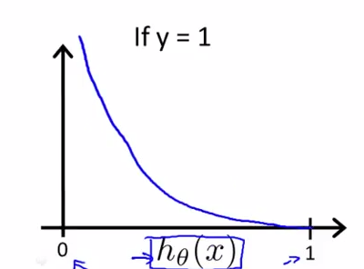
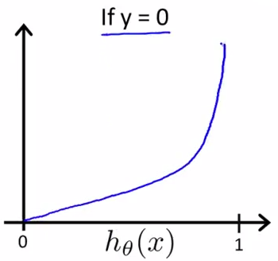
Cost function for logistic regression

Slide 12
Estimate Parameters
Minimize the total cost
Find the best set of parameters θ
Methods: Gradient descent, mean square

Slide 13
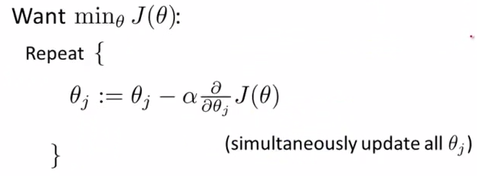
Gradient descent to find parameters
Step 1. randomly assign values to θ
Step 2. update θ according to following algorithm until reach the minimum J(θ).

Slide 14
Mean Square method
Let X be the feature matrix, the class labels be Y vector, then we can calculate
the parameters directly as

Slide 15
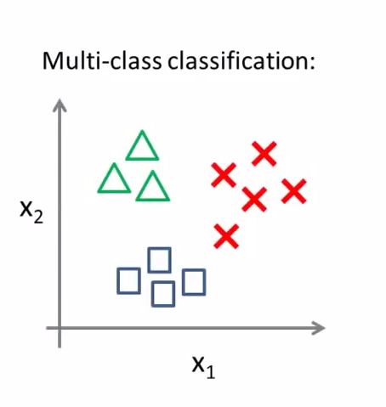
Multinomial Classification
Emails: Spam, work, personal
Y=1,2,3
Weather: sunny, rain, snow, windy
Y=1,2,3,4

Slide 16
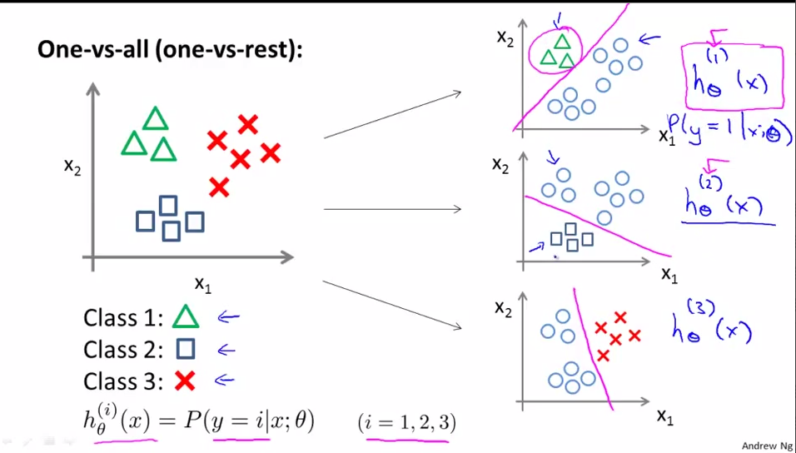
One-vs-all Regression

Slide 17
One-vs-all Summary
Train a logistic regression classifier
For each class i to predict the probability that y=i
For k classes, we need to train k classifiers
Given a new input x, feed x into the each of the classifier, pick the class i that maximize the probability

Slide 18
Norm
Norm is a total size or length of all vectors in a vector space or matrices
Given a vector space V, a norm on V is a function p: V→R with the following properties:
p(av)=|a|p(v) (absolute homogeneity)
P(u+v)<= p(u)+p(v) (triangle inequality)
If p(v)=0, then v is the zero vector
Source: http://en.wikipedia.org/wiki/Norm_(mathematics)

Slide 19
Ln Norm
Let x to be a vector or a matrix, then the ln norm of x is defined as
Mathematic properties of difference norm are very different
Source http://rorasa.wordpress.com/2012/05/13/l0-norm-l1-norm-l2-norm-l-infinity-norm/

Slide 20
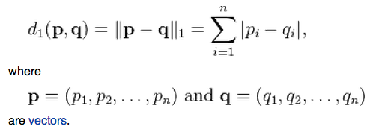
L1-norm (Manhattan norm)
Defined as
Manhattan distance defined as
http://en.wikipedia.org/wiki/Taxicab_geometry

Slide 21
L2-Euclidean norm
Defined as
Euclidean distance defined as

Slide 22
Example
V = (1,2,3)
Norm | Symbol | Value | Numerical
L1 | |x|₁ | 1+2+3=6 | 6.000
L2 | |x|₂ | √1+4+9=√14 | 3.742

Slide 23
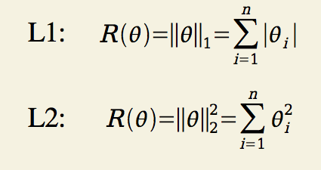
L1&L2 regulation
Goal
Regulation
http://cs.nyu.edu/~rostami/presentations/L1_vs_L2.pdf

Slide 24
Sources
“Machine Learning” Online Course, Andrew Ng,http://openclassroom.stanford.edu/MainFolder/CoursePage.php?course=MachineLearning
Afshin Rostami, Andew Ng. "L1 vs. L2 Regularization and feature selection.” 2004, http://cs.nyu.edu/~rostami/presentations/L1_vs_L2.pdf.
JerryLead, 2011, http://www.cnblogs.com/jerrylead/archive/2011/03/05/1971867.html
http://en.wikipedia.org/wiki/Logistic_regression
Book of Rorasa, http://rorasa.wordpress.com/2012/05/13/l0-norm-l1-norm-l2-norm-l-infinity-norm/

