Slide 1
Support vector machine
Nonparametric Supervised Learning

Slide 2
Outline
Context of the Support Vector Machine
Intuition
Functional and Geometric Margins
Optimal Margin Classifier
Linearly Separable
Not Linearly Separable
Kernel Trick
Aside: Lagrange Duality
Summary
Note: Most figures are taken from Andrew Ng’s Notes on Support Vector Machines

Slide 3
Outline
Context of the Support Vector Machine
Intuition
Functional and Geometric Margins
Optimal Margin Classifier
Linearly Separable
Not Linearly Separable
Kernel Trick
Aside: Lagrange Duality
Summary
Note: Most figures are taken from Andrew Ng’s Notes on Support Vector Machines

Slide 4
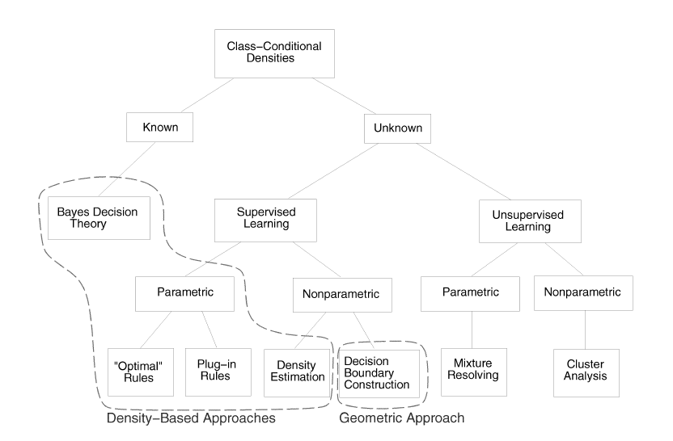
Context of Support Vector Machine
Supervised Learning: we have labeled training samples
Nonparametric: the form of the class-conditional densities is unknown
Explicitly construct the decision boundaries
Figure: various approaches in statistical pattern recognition (SPR paper)

Slide 5
Outline
Context of the Support Vector Machine
Intuition
Functional and Geometric Margins
Optimal Margin Classifier
Linearly Separable
Not Linearly Separable
Kernel Trick
Aside: Lagrange Duality
Summary
Note: Most figures are taken from Andrew Ng’s Notes on Support Vector Machines

Slide 6
Intuition
Recall logistic regression
P(y = 1|x,θ) is modeled by h_{θ}(x)=g(θ^{T}x)
Predict y = 1 when g(θ^{T}x) ≥ 0.5 (or θ^{T}x ≥ 0)
We are more confident that y = 1 ifθ^{T}x≫0
Line is called separating hyperplane

Slide 7
Intuition
Want to find the best separating hyperplane so that we are most confident in our predictions
A: θ^{T}x≫0
Confident in our prediction
C: θ^{T}x is close to 0
Less confident in our prediction

Slide 8
Outline
Context of the Support Vector Machine
Intuition
Functional and Geometric Margins
Optimal Margin Classifier
Linearly Separable
Not Linearly Separable
Kernel Trick
Aside: Lagrange Duality
Summary
Note: Most figures are taken from Andrew Ng’s Notes on Support Vector Machines

Slide 9
Functional and Geometric Margins
Classifying training examples
Linear classifier h_{θ}(x)=g(θ^{T}x)
Features x and labels y
g(z) = 1 if z ≥0
g(z) = -1 otherwise
Functional margin: =y^{(i)}(θ^{T}x^{(i)})
If >0, our prediction is correct
≫0 means our prediction is confident and correct

Slide 10
Functional and Geometric Margins
Given a set S of m training samples, the functional margin of S is given by =min_{i=1,2,…m}
Geometric Margin:
Where w = [θ₁ θ₂…θ_{n}]
Now, the normal vector is a unit normal vector
Geometric margin with respect to set S

Slide 11
Outline
Context of the Support Vector Machine
Intuition
Functional and Geometric Margins
Optimal Margin Classifier
Linearly Separable
Not Linearly Separable
Kernel Trick
Aside: Lagrange Duality
Summary
Note: Most figures are taken from Andrew Ng’s Notes on Support Vector Machines

Slide 12
Optimal Margin Classifier
To best separate the training samples, want to maximize the geometric margin
For now, we assume training data are linearly separable (can be separated by a line)
Optimization problem:

Slide 13
Optimal Margin Classifier
Optimization problem:
Constraint 1: Every training example has a functional margin greater than
Constraint 2: The functional margin = the geometric margin

Slide 14
Optimal Margin Classifier
Problem is hard to solve because of non-convex constraints
Transform problem so it is a convex optimization problem:
Solution to this problem is called the optimal margin classifier
Note: Computer software can be used to solve this quadratic programming problem

Slide 15
Problem with This Method
Problem: a single outlier can drastically change the decision boundary
Solution: reformulate the optimization problem to minimize training error

Slide 16
Non-separable Case
Two objectives:
Maximizing margin by minimizing
Make sure most training examples have a functional margin of at least 1
Same idea for non-separable case

Slide 17
Non-linear case
Sometimes, a linear classifier is not complex enough
From “Idiot’s Guide”: Map data into a richer feature space including nonlinear features, then construct a hyperplane in that space so that all other equations are the same
Preprocess the data using a transformation
Then, use a classifier f(x) = w + b

Slide 18
Outline
Context of the Support Vector Machine
Intuition
Functional and Geometric Margins
Optimal Margin Classifier
Linearly Separable
Not Linearly Separable
Kernel Trick
Aside: Lagrange Duality
Summary
Note: Most figures are taken from Andrew Ng’s Notes on Support Vector Machines

Slide 19
Kernel Trick
Problem: can have large dimensionality, which makes w hard to solve for
Solution: Use properties of Lagrange duality and a “Kernel Trick”

Slide 20
Lagrange Duality
The primal problem:
The dual problem:
Optimal solution solves both primal and dual
Note that is the Lagrangian
are the Lagrangian multipliers

Slide 21
Lagrange Duality
Solve by solving the KKT conditions
Notice that for binding constraints only

Slide 22
Lagrange Duality
Our binding constraint is that a point is the minimum distance away from the separating hyperplane
Thus, our non-zero ‘s correspond to these points
These points are called the support vectors

Slide 23
Back to the Kernel Trick
Problem: can be very large, which makes w hard to solve for
Solution: Use properties of Lagrange duality and a “Kernel Trick”
Representer theorem shows we can write w as:

Slide 24
Kernel Trick
Before our decision rule was of the form:
Now, we can write it as:
Kernel Function is

Slide 25
Kernel Trick
Why do we do this?
To reduce the number of computations needed
We can work in highly dimensional space and Kernel computations still only take O(n) time.
Explicit representation may not fit in memory but kernel only requires n multiplications

Slide 26
Kernel Trick
RBF kernel: One of most popular kernels

Slide 27
Outline
Context of the Support Vector Machine
Intuition
Functional and Geometric Margins
Optimal Margin Classifier
Linearly Separable
Not Linearly Separable
Kernel Trick
Aside: Lagrange Duality
Summary
Note: Most figures are taken from Andrew Ng’s Notes on Support Vector Machines

Slide 28
Summary
Intuition
We want to maximize our confidence in our predictions by picking the best boundary
Margins
To do this, we want to maximize the margin between most of our training points and the separating hyperplane
Optimal Classifier
Solution is a hyperplane that solves the maximization problem
Kernel Trick
For best results, we map x into a highly dimensional space
Use the kernel trick to keep computation time reasonable

Slide 29
Sources
Andrew Ng’s SVM Notes
http://cs229.stanford.edu/notes/cs229-notes3.pdf
An Idiot’s Guide to Support Vector Machines
R. Berwick, MIT
http://www.svms.org/tutorials/Berwick2003.pdf

Slide 30
Thank you
Any questions?

