Slide 1
Bayesian Theorem & Spam Filtering
Conditional probability, law of total probability, Bayesian theorem, application to spam tiltering

Slide 2
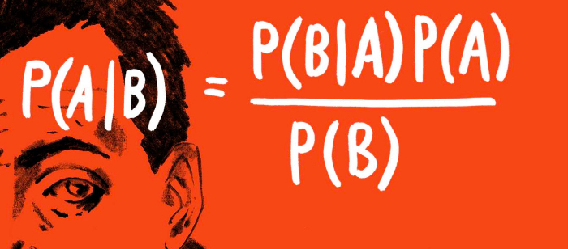
Bayes’ Theorem
Thomas Bayes (1701-1761)
http://priorwisdom.wordpress.com/

Slide 3
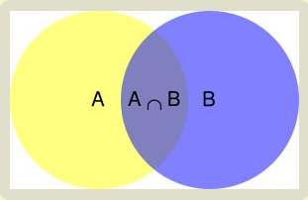
Conditional Probability

Slide 4
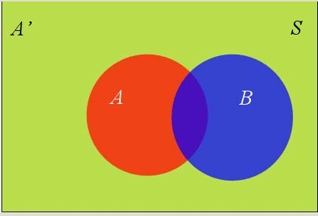
Law of Total Probability
Another way to write the conditional probability:

Slide 5
Bayesian Interpretation
Likelihood/Marginal >1 : increase the prior given the evidence
Likelihood/Marginal <1 : decrease the prior given the evidence

Slide 6
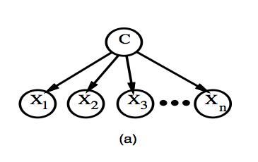
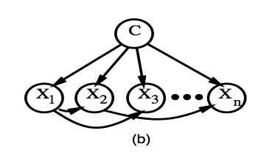
Naïve Bayesian Assumption
Assume instances are independent with every other

Slide 7
Application to Spam Filtering
http://www.deepakarora.com/

Slide 8
Example on single event
I just received an email E and want to know if it is spam
S: spam H: healthy
Before any analysis, assume:
Scan through this email, found word “apple”
What is the probability that E is spam given it contains “apple” ?

Slide 9
CONT.
We found that in training dataset
P(W|S)=5%, P(W|H)=0.05%
P(S)=50%, P(H)=50%
Existence of word “apple” in email E increased the previous 50% probability (prior) to 99% (posterior)
Thus, “apple” is a pretty strong indication of spam and
This quantity is also called the “spamicity”

Slide 10
Multiple Events
Calculate P(S|W) for every word W
Sort P(S|W) in ascending order and select top 15 words and form a set W
If the word W shows up the first time in the testing email, assume P(S|W)=0.4
Scan through the testing email and identify the words in W.

Slide 11
An email contains 2 words in W
According to assumption of Naïve Bayesian classifier, each feature W_{i} is conditionally independent from every other features
Event | W1 | W2 | Spam
E1 | yes | yes | YES
E2 | yes | yes | NO
Event | W1 | W2 | Spam
E1 | P(S|W1) | P(S|W2) | P(S)
E2 | 1-P(S|W1) | 1-P(S|W2) | 1-P(S)

Slide 12
Rely on previous independent assumption
Event | W1 | W2 | Spam
E1 | P(S|W1) | P(S|W2) | P(S)
E2 | 1-P(S|W1) | 1-P(S|W2) | 1-P(S)
P(S|W1&W2)=

Slide 13
The Combined Probability
Let P(S|W1)=P1, P(S|W2)=P2, the combined probability
P(S|W1&W2)=
For 15 words:
For N words:

Slide 14
Setting Cut-off Value
P=probability that the suspect email E is spam
P1=P(S|W1)=probability that E containing W1(e.g. “apple”) is spam
Pi=P(S|Wi)=probability that E containing Wi(e.g. tiger) is spam
When P>0.9, classify as spam, otherwise, classify as healthy email

Slide 15
Advantages
Disadvantages
Adaptive to user’s specific patterns
Good at avoiding “false positives”
e.g. An email contains “Nigeria” would be rejected by pre-defined rule filter; while Bayesian filter would consider the name of spouse ,which would outweigh the word “Nigeria”
Spammer send picture message instead that the filter couldn’t analyze
Random insert normal text
Modify the words
E.g. Nigeria→Niigeriaa

Slide 16
Resources
http://en.wikipedia.org/wiki/Bayesian_spam_filtering#Computing_the_probability_that_a_message_containing_a_given_word_is_spam
http://www.ruanyifeng.com/blog/2011/08/bayesian_inference_part_one.html
http://www.ruanyifeng.com/blog/2011/08/bayesian_inference_part_two.html
http://www.paulgraham.com/spam.html

