Slide 1
Performance Measures & unsupervised Learning

Slide 2
Outline
Performance measures
Accuracy
Precision
Recall
F-score
ROC
Unsupervised Learning

Slide 3
Performance Measures
Different outcomes for classifications
 | Classified Positive | Classified Negative
Positive Examples | True Positive (TP) | False Negative (FN)
Negative Examples | False Positive (FP) | True Negative (TN)

Slide 4
Performance Measures
Accuracy
Proportion of classifications that were correct
(TP + TN) / # of Training Examples
Recall
Proportion of positive examples that were correctly classified
TP/ (TP + FN)
Precision
Proportion of correct positive classifications over all positive classifications
TP/(TP + FP)

Slide 5
Performance Measures
Accuracy
 | Classified Positive | Classified Negative
Positive Examples | True Positive (TP) | False Negative (FN)
Negative Examples | False Positive (FP) | True Negative (TN)
 |  |  | Accuracy = (TP + TN) / All Examples

Slide 6
Performance Measures
Recall
 | Classified Positive | Classified Negative
Positive Examples | True Positive (TP) | False Negative (FN)
Negative Examples | False Positive (FP) | True Negative (TN)
 | Recall = TP/ (TP + FP)

Slide 7
Performance Measures
Precision
 | Classified Positive | Classified Negative
Positive Examples | True Positive (TP) | False Negative (FN) | Precision = TP/(TP + FN)
Negative Examples | False Positive (FP) | True Negative (TN)

Slide 8
Performance Measures
Select which performance measure works best

Slide 9
Precision vs. Recall
There is a trade-off between precision and recall
Precision: How often does system correctly classify spam emails?
Recall: How often are emails classified as spam actually spam?
Precision/ Recall Curves

Slide 10
F-Score
“Harmonic average of precision and recall”
F = 2 * (Precision * Recall) / (Precision + Recall)
Break-even point is the point where precision = recall

Slide 11
ROC Plots
Receiver Operator Characteristic
Sweep your threshold
Plot true positive rate vs. false positive rate
True Positive Rate = Recall = TP / (TP + FN)
False Positive Rate = FP / (FP + TN)

Slide 12
Performance Measures
Thresholds will vary depending on what you choose to optimize
Pick a performance measure that makes sense for your problem
ROC is becoming more popular in the machine learning community

Slide 13
Outline
Performance measures
Accuracy
Precision
Recall
F-score
ROC
Unsupervised Learning
K-Means

Slide 14
Unsupervised Learning

Slide 15
Unsupervised Learning
Training examples are not labeled
No target attribute we want to predict
Want to find some structure in the data

Slide 16
K-Means
Clustering algorithm
Partition the data into k clusters
Each group has a “centroid”
Choose center that

Slide 17
K-Means
Algorithm

Slide 18
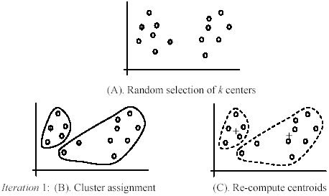
K-Means
Example of k-Means

Slide 19
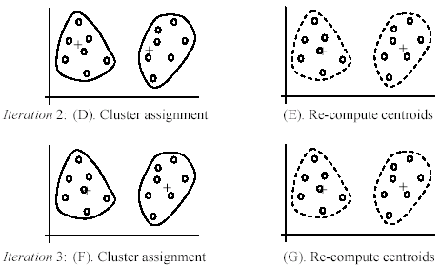
K-Means
Example of k-Means

Slide 20
Pros of K-Means
Simple to understand
Easy to implement
Efficient: O(tkn) – considered linear time
k = number of clusters
t = number of iterations
n = number of data points

Slide 21
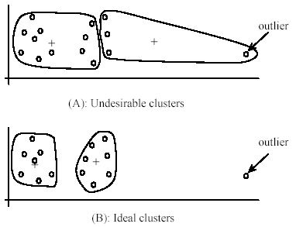
Cons of K-Means
Only applicable to cases where the mean is defined
User needs to choose k
Might not know best k to choose
Algorithm is sensitive to outliers

Slide 22
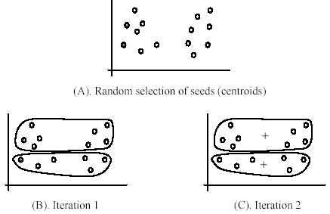
Cons of K-Means
Sensitive to the initial centroids

Slide 23
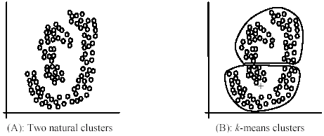
Cons of K-Means
Hard to discover clusters than are not ellipsoids

Slide 24
Sources
CS583, Bing Liu, UIC
Unsupervised Learning
University of Texas, San Antonio
Unsupervised Learning k-Means Algorithm
CS578 Cornell
Performance Measures
Portland State University, CS
Evaluating and Comparing the Performance of Machine Learning Algorithms

Slide 25
Thank you
Any questions?

